Slide 1

Compilers
Principles, Techniques, & Tools
Taught by Jing Zhang
(jzhang@njust.edu.cn)

Slide 2
Lexical Analysis

Slide 3
Outlines
The Construction of a Lexical Analyzer
Regular Expression, Regular Set
Transition Diagram
Lex
DFA and NFA
Conversion of an NFA to a DFA
Minimization of DFA
Conversion among FA, Regular Expression, & Regular Grammar

Slide 4
3.1 The Construction of a Lexical Analyzer
Lexical Analyzer reads input stream and then generator the sequence of tokens that are required by a parser.
token
Lexical Analyzer
Parser
getNextToken
Symbol Table
Sometimes, lexical analyzers are divided into a cascade of two processes:
a) Scanning consists of the simple processes that do not require tokenization of the input, such as deletion of comments and compaction of consecutive whitespace characters into one.
b) Lexical analysis proper is the more complex portion, where the scanner produces the sequence of tokens as output.

Slide 5
3.1 The Construction of a Lexical Analyzer
Lexical Analysis Versus Parsing
1 . Simplicity of design is the most important consideration. The separation of lexical and syntactic analysis often allows us to simplify at least one of these tasks. For example, a parser that had to deal with comments and whitespace as syntactic units would be. considerably more complex than one that can assume comments and whitespace have already been removed by the lexical analyzer. If we are designing a new language, separating lexical and syntactic concerns can lead to a cleaner overall language design.
2. Compiler efficiency is improved. A separate lexical analyzer allows us to apply specialized techniques that serve only the lexical task, not the job of parsing. In addition, specialized buffering techniques for reading input characters can speed up the compiler significantly. (Parsing is more complicated and slower)
3. Compiler portability is enhanced. Input-device-specific peculiarities can be restricted to the lexical analyzer.

Slide 6
3.1 The Construction of a Lexical Analyzer-token
Output of a lexical analyzer：token
Token is a 2-tuple
<name，attribute>
attribute：a point to an entry in Symbol Table
Token name
Keyword：if, while, switch, … (any keyword as a token name)
Identifier：variables, functions, classes… defined by users … (all identifiers have one token name id)
Constant：integer，float, Boolean，literature （Each type has a token name）
Operator：+, -, *, /, %, … （each operator has a token name or each type has a token）
Delimiter：;, {, /**/, … (each delimiter has as token name)

Slide 7
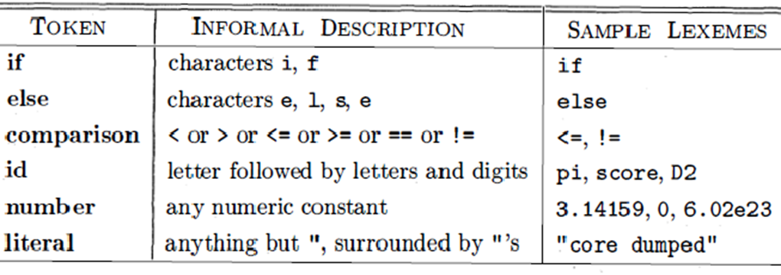
3.1 The Construction of a Lexical Analyzer-token
Token, Pattern and Lexemes
A token is a pair consisting of a token name and an optional attribute value. The token name is an abstract symbol representing a kind of lexical unit.
A pattern is a description of the form that the lexemes of a token may take. In the case of a keyword as a token, the pattern is just the sequence of characters that form the keyword. For identifiers and some other tokens, the pattern is a more complex structure that is matched by many strings.
A lexeme is a sequence of characters in the source program that matches the pattern for a token and is identified by the lexical analyzer as an instance of that token.

Slide 8
3.1 The Construction of a Lexical Analyzer-tokenization
while (i > j) {
k = j * 3.14;
}
<WHILE, ->
<LEFT_PAREN, ->
<ID, pointer to ST entry for i>
<REL_OP, GT>
<ID, pointer to ST entry for j>
<RIGHT_PAREN, ->
<LEFT_BRACE, ->
<ID, pointer to ST entry for k >
<OP_ASSIGN, ->
<ID, pointer to ST entry for j >
<OP_MULT, ->
<REAL, pointer to constant 3.14>
<SEMICOLON, ->
<RIGHT_BRACE,->

Slide 9
3.1 The Construction of a Lexical Analyzer-Lexical Errors
It is hard for a lexical analyzer to tell , without the aid of other components, that there is a source-code error.
The simplest recovery strategy is "panic mode" recovery. We delete successive characters from the remaining input, until the lexical analyzer can find a well-formed token at the beginning of what input is left.
Other possible error-recovery actions are:
(1) Delete one character from the remaining input.
(2) Insert a missing character into the remaining input.
(3) Replace a character by another character.
(4) Transpose two adjacent characters

Slide 10
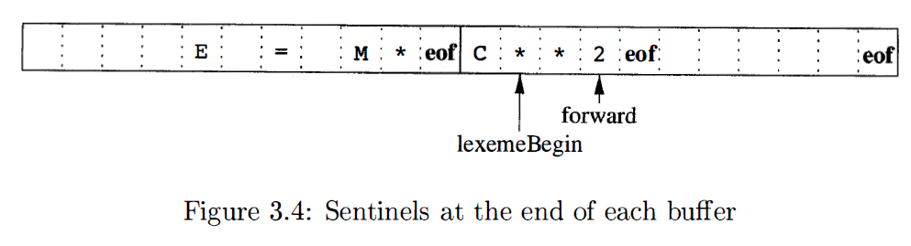
3.1 The Construction of a Lexical Analyzer-Input Buffering
Buffer Pairs
Used to extract lexemes from input streams
Sentinel
Using eof to indicate the end of buffer or input

Slide 11
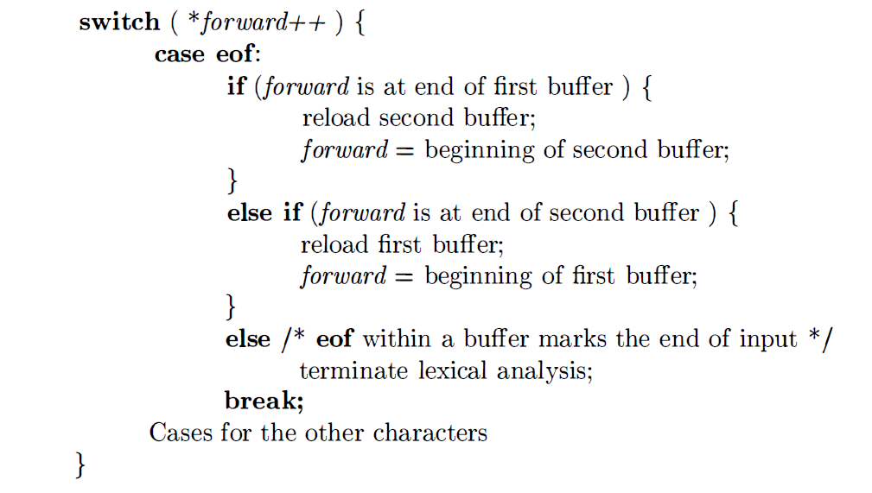
3.1 The Construction of a Lexical Analyzer-Lookahead code with sentinels

Slide 12
3.1 The Construction of a Lexical Analyzer-reading ahead
Keywords recognition
Identifiers
Usually do not need reading ahead
Constant recognition
5.EQ.M and 5.E08
Operators and Delimiters
++,--, /**, >=
1 DO 99 K = 1, 10
2 IF(5.EQ.M) I=10
3 DO 99 K = 1.10
4 IF(5)=55

Slide 13
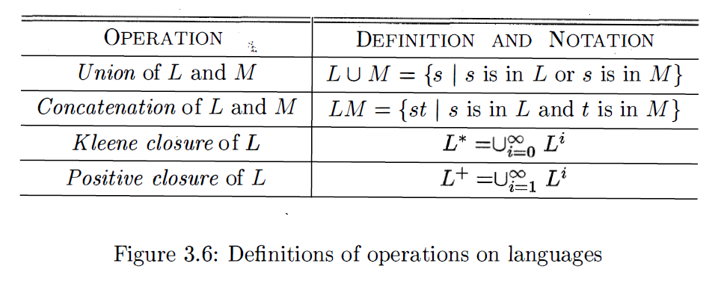
3.2 Regular Expression, Regular Set - Regular Expressions
Review – Operations on Languages
A language is any countable set of strings over some fixed alphabet.

Slide 14
3.2 Regular Expression, Regular Set - Regular Expressions
Regular Expressions over alphabet ∑ are recursively defined as follows：
（1）ε and ϕ are regular expressions， which represent language {ε} and ϕ respectively.
（2）for any a∊ ∑，a is a regular expression，and
（3）U and V are both regular expressions，whose represented languages are L(U) and L(V) respectively. Then，(U|V), (U⋅V) and (U)* are all regular expressions，whose represented languages are L(U)⋃L(V), L(U)L(V) and (L(U))*
Expressions that are defined by finitely applying the above laws are regular expressions. The string set that is only defined by regular expressions is called a regular set.
Precedence of operators：*，⋅，|

Slide 15
3.2 Regular Expression, Regular Set - Regular Expressions – Examples
∑={a, b}
1. ba* strings starting with b followed by zero or more a
2. a(a|b)* strings starting with a
3. (a|b)*(aa|bb)(a|b)* strings containing two consecutive a (or b)
4. (aa|bb)*((ab|ba)(aa|bb)*(ab|ba)(aa|bb)*)*
5. (aa|bb|((ab|ba)(aa|bb)*(ab|ba)))*
Languages defined by 4 and 5 are strings that contain even numbers of a and even numbers of b.

Slide 16
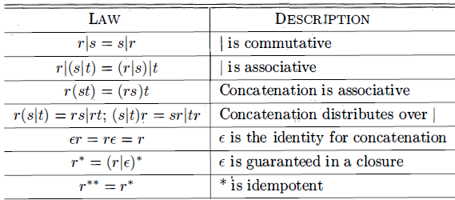
3.2 Regular Expression, Regular Set - Characteristics

Slide 17
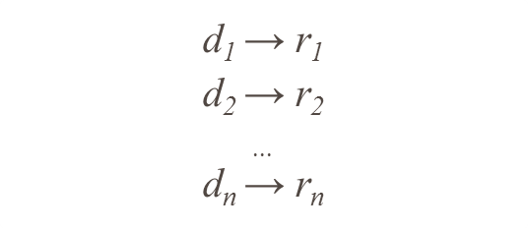
3.2 Regular Expression, Regular Set - Regular Definition
For notational convenience, we may wish to give names to certain regular expressions and use those names in subsequent expressions, as if the names were themselves symbols. If is an alphabet of basic symbols, then a regular definition is a sequence of definitions of the form:
Where (1) each is a new symbol, not in and not the same as any other of the d’s, and
(2) Each is a regular expression over the alphabet

Slide 18
3.2 Regular Expression, Regular Set - Regular Definition Example
Identifies in C programming language
letter_ → A|B|...|Z|a|b|...|z|_
digit → 0|1|...|9
id → letter_(letter_|digit)*
Unsigned number (integer or float) in C programming language
digit → 0|1|...|9
ligits → digit digit*
optionalFraction → .digits | ε
optionalExponent → (E(+|-| ε) digits )| ε
number → digits optionalFraction optionalExponent

Slide 19
3.2 Regular Expression, Regular Set – Extensions for Regular Definition
One or more instance：+
r+ = rr*
r* = r+| ε
Zero or one instances：？
r? = r | ε
Character class
[a₁ a₂ a_{3...} a_{n}] is equivalent to a₁ |a₂|a₃|... |a_{n}
[a-z] is equivalent to a|b|c|...|z

Slide 20
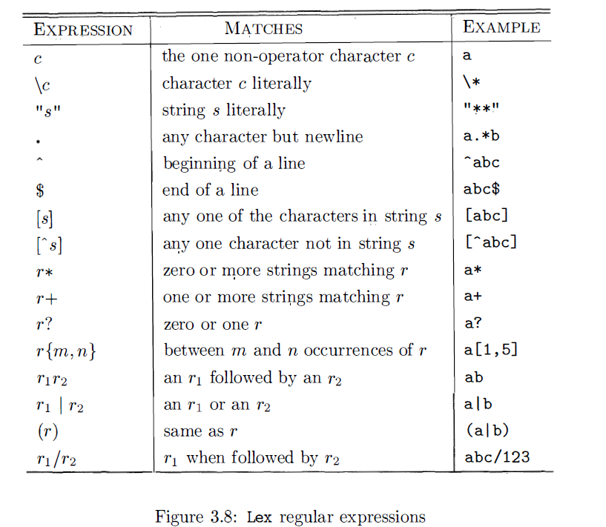
3.2 Regular Expression, Regular Set – Extensions for Regular Definition
Some software defines more complicated extensions for regular expression

Slide 21
3.2 Regular Expression, Regular Set – Regular Grammar
【Review】Chomsky Type-3 Grammar
G=(V_{T}, V_{N}, S, 𝓟), where each production has the form: （1）A → αB| α，where α∊ V_{T}*， B ∊ V_{N}（right linear grammar）
Or，
（2）A → Bα| α，where α∊ V_{T}*， B ∊ V_{N}（left linear grammar）
Regular Language
Regular Set
Regular Expression
Regular Definition
Regular Grammar

Slide 22
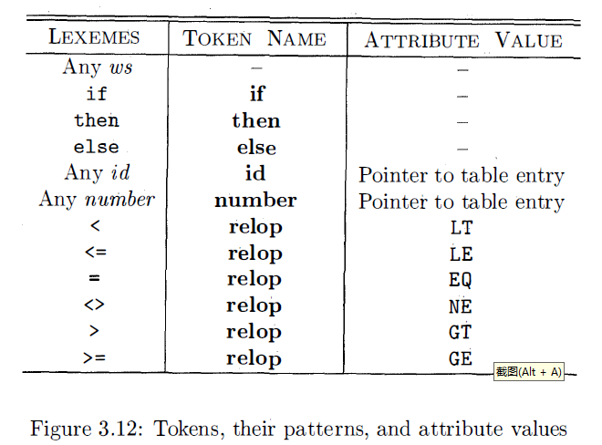
3.3 Transition Diagram – Recognition of Token
A small running example – A grammar for branching statements
stmt -> if expr then stmt | if expr then stmt else stmt | ε
expr -> term relop term | term
term -> id | number
The goal for the lexical analyzer.

Slide 23
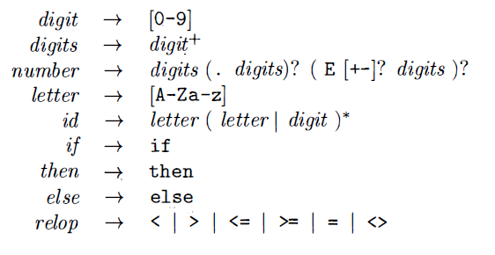
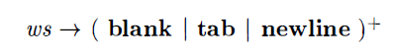
3.3 Transition Diagram – Recognition of Token
Patterns for token of the example

Slide 24
3.3 Transition Diagram – Recognition of Token
Transition Diagrams is a technical method to recognize regular expression
Transition Diagram is a finite directed graph, where nodes (circles) are called states. Each state represents a condition that could occur during the process of scanning the input looking for a lexeme that matches one of several patterns. Edges are directed from one state of the transition diagram to another. Each edge is labeled by a symbol or set of symbols. If we are in some state s , and the next input symbol is a, we look for an edge out of staXte s labeled by a (and perhaps by other symbols, as well). If we find such an edge, we advance the forward pointer and enter the state of the transition diagram to which that edge leads. A transition diagram include finite states, in where one is designated the start (initial) state and at least one is said to be the accepting (final) state (double circle).

Slide 25
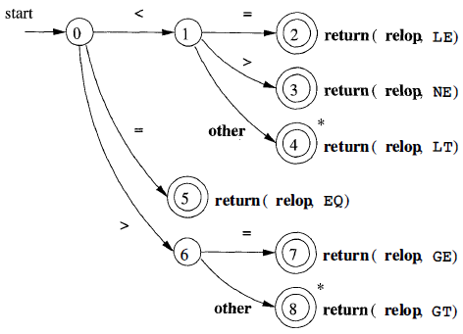
3.3 Transition Diagram – Recognition of relation operator
to indicate that we must retract the input one position

Slide 26
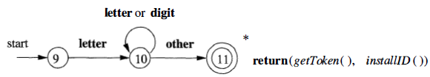
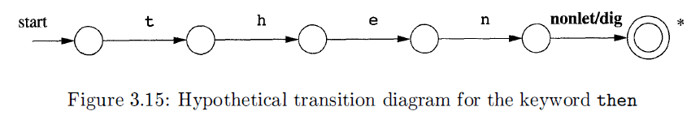
3.3 Transition Diagram – Recognition of reserved words and identifiers

Slide 27
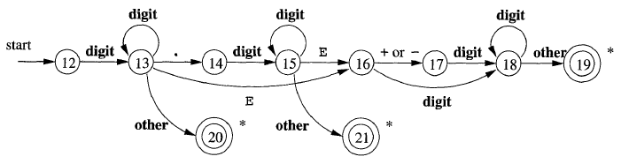
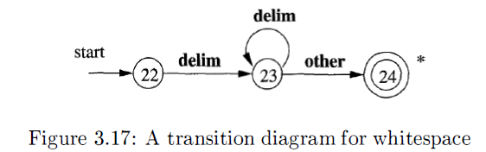
3.3 Transition Diagram – Recognition of unsigned number and others
Unsigned number
other
Err
Whitespace

Slide 28
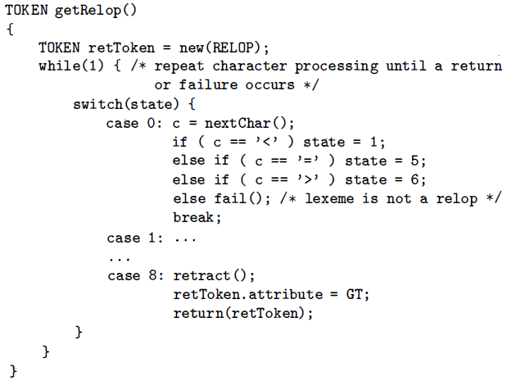
3.3 Transition Diagram – Architecture of a Transition-Diagram-Based Lexical Analyzer

Slide 29
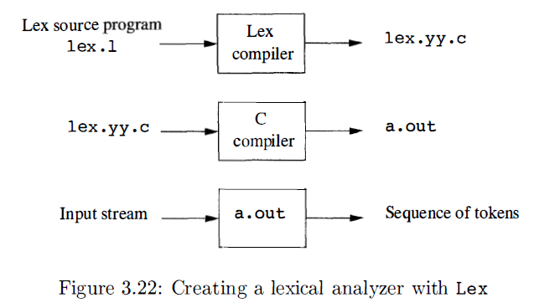
3.5 Lex
Lex is used to generate Lexical analyzers. Users can use Lex language to design their own Lexical analyzers.

Slide 30
3.5 Lex
A Lex program has the following form:
declarations
%%
translation rules
%%
auxiliary functions
The translation rules each have the form
Pattern {Action}

Slide 31
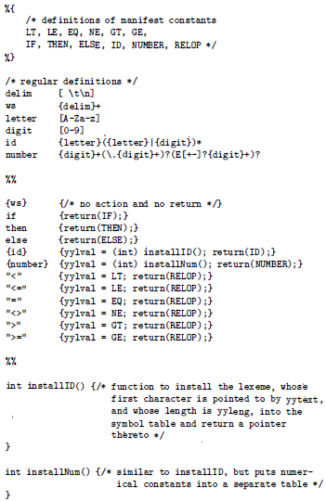
3.5 Lex
Conflict Resolution
Always prefer a longer prefix to a shorter prefix;
If the longest possible prefix matches two or more patterns, prefer the pattern listed first in the Lex program.

Slide 32
3.5 DFA and NFA – introduction
Formal and accurate
Regular Grammar
Regular Expression
Regular Definition
recognize
recognize
Transition Diagram
Formalize
Finite Automata
Formal and accurate
Formal, accurate
（technique）
informal，inaccurate（technique）

Slide 33
3.5 DFA and NFA – description
Finite automata are recognizers; they simply say "yes" or "no" about each possible input string
Finite automata come in two flavors:
(1) Deterministic finite automata (DFA) have, for each state, and for
each symbol of its input alphabet exactly one edge with that symbol
leaving that state
(2) Nondeterministic finite automata (NFA) have no restrictions on the labels of their edges. A symbol can label several edges out of the same state, and ε, the empty string, is a possible label.
Conclusion: Both deterministic and nondeterministic finite automata are capable of recognizing the same languages.

Slide 34
3.5 DFA and NFA – definition
DFA
M={S, ∑, δ, s₀, F}
S: a set of finite state
∑ is finite alphabet, where each element is a input symbol.
δ is a mapping from S ×∑ to one state in S。 δ(s, a)=s’ ：when current state is s，if the input symbol is a , then the transition of the next state is s’
s₀∊S is a unique start state
F⊆S is a set of final states（can be empty ）
NFA
M={S, ∑, δ, S₀, F}
S: a set of finite state
∑ is finite alphabet, where each element is a input letter.
δ is a mapping from S ×∑* to a subset of S，i.e., δ: S ×∑* →2^{S}
S₀ ⊆ S is a non-empty set of start stats
F⊆S is a set of final states (can be empty).

Slide 35
3.5 DFA and NFA – Example
Recognize strings on ∑={a, b} that include two consecutive a or two consecutive b
1
DFA
a
a
start
a
0
b
a
3
b
b
2
b
NFA
a
3
a
a
a
start
5
ε
1
2
ε
6
b
b
4
b
b
Notes:
这里给出一个例子。图中的DFA和NFA都是识别字符集∑={a, b}上含有相继两个a或者相继两个b的串。可以看到，DFA中每个状态都对应两条弧，这两条弧上的标签分别是a和b，而NFA不受此限制。弧上的标记可以是a，也可以是b，或者是ab的串，甚至是空字ε，每个状态的出弧也不要求必须和字母表中的字母数一样。另外，从这个例子，我们可以直观的看到，首先DFA和NFA两者的描述能力是等价的，其次，NFA具备比DFA更好的可读性。这也就是为什么使用NFA来构造识别器比较方便的原因。比如这里，只要将相继的两个a和相继的两个b作为整个NFA中的两个成分，在加上收尾的开始和结束状态，就很容易构造出NFA，但是如果想凭空构造出DFA就比较困难了。但是，DFA的好处就是，它的状态转换是确定的，便于程序处理。

Slide 36
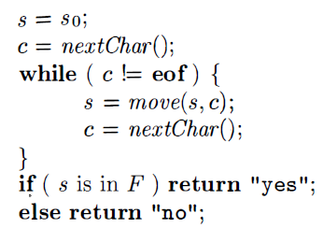
3.5 DFA and NFA – Simulation of DFA
Input：String x with eof in the end，DFA（s₀ is the initial state，F is a set of final state, and transition function move ）
Output：“yes” if x is accepted, otherwise， “no”

Slide 37
3.6 Convert NFA to DFA（subset construction）
Some Changes to NFA
（1）Add a unique initial stat X and a unique final state Y
Create ε edge from X to each state in S_{0,} Create ε edge from each state in F to Y, states in S₀ and F become normal states.
a
3
a
a
a
start
X
ε
5
ε
1
2
ε
6
ε
Y
b
b
4
b
b
Notes:
既然NFA利于设计，而DFA利于计算机自动处理，生成代码。那么从NFA转换为DFA的算法就十分关键。这个算法称为“子集法”。为了便于子集法将NFA转换为DFA，我们要对NFA首先做一些简单的处理。第一个简单处理：因为在NFA中，初始状态和终结状态都是集合，所以我们增加一个唯一的初始状态X和一个唯一的终结状态Y。X与初始状态集中的每个状态建立一条ε弧，终结状态集中的每个状态到Y建立一条ε弧，并将原来的初始状态和终结状态全部变为普通状态。图中状态5和状态6分别是原来的初态和终态。现在加上新的X和Y后变成这样。

Slide 38
3.6 Convert NFA to DFA（subset construction）
Some Changes to NFA
（2）For edges with composed labels, we apply three conversions as follows.
i
AB
j
i
A
B
k
j
A
i
A|B
j
i
j
B
A
b
i
ε
k
ε
j
i
A*
j
Notes:
第二个简单处理，将NFA中具有复杂标签的弧和节点实施以下三种变换。对于“连接”，增加一个中间状态k，对于“或”，变成两条弧，对于闭包，增加一个中间状态K和两条ε弧。

Slide 39
3.6 Convert NFA to DFA（subset construction）
Auxiliary Functions
For a state set I, ε_CLOSURE(I) is defined as：
（1）a state q∊ ε_CLOSURE(I), if q∊I
（2） a state r∊ ε_CLOSURE(I), if r is a state reachable from some state q in I on ，ε-transition alone. (i.e., one or more ε-edge)
a-transition set of the state set I, notated as move(I, a), is defined as:
For any state q∊I，r∊ move(I, a), if r is a state to which there is a transition on input symbol a from q.
Denote I_{a}=ε_CLOSURE(move(I, a))
Notes:
做完上面两个简单处理后我们就可以正式进入“子集法”转换算法了。在描述算法之前，我们先定义一些帮助标记的辅助函数。第一个称为状态集I的ε闭包。它是这样定义的，首先状态集I中的所有状态本身肯定在这个闭包中。其次从I中的状态出发，经过任意多的ε弧能够到达的状态r也在这个闭包中。
第二个辅助函数，称为状态集I的a转移集，定义为move（I，a）。这个集合定义了那些从I中的状态出发经过一条a弧能够到达的状态集。其中a是字母表中的一个字母。
有了这两个辅助函数，我们将状态集I的a转移集的ε闭包简单记为Ia。可见，Ia也是一个集合。

Slide 40
3.6 Convert NFA to DFA（subset construction）
Alphabet ∑={a₁, a₂, ..., a_{k}}；Input：NFA；Output：DFA
Algo: (1) construct a table with k+1 columns，where states in the zero-th column compose the states of the output DFA. Sets I_{a1}…I_{ak} are in the columns 1…k:
0
1
k
0
I | I_{a1} | ... | I_{ak}
ε_CLOSURE(X) | ε_CLOSURE(move(I, a₁))
1
2
(2) ε_CLOSURE(X) is in row 1 column 0，From this set , we construct sets I_{a1}, ..., I_{ak} for row 1，and fill them in the corresponding positions . Once we fill a set, we exam all sets in column 0. If we cannot find the same set in column 0, we fill this set in the last empty position in column 0.
(3) step (2) is continued until the sets in column 0 do not increase any more and the entire table is completed.
(4) For all sets in column 0, we re-assign sequential numbers (start from 0) on them. For all sets in other columns, they are then substituted with their sequential numbers . The numbers stand for the names of the states in DFA. The state that includes X is the unique initial state and those states that include Y are final states.
The final table are transition table for DFS. Algorithm done.
Notes:
这里就是算法的描述。假设字母表∑中有k个字母，算法的输入时NFA，输出是和这个NFA等价的DFA。
第一步，构造一个k+1列的表格，其中第0列为最终的DFA状态集合，第1到k列为集合Ia1到Iak。其中Ia1的定义就是a1转移集的ε闭包。表的第0行是表头，从第1行第0列开始。
第二步，第1行第0列是初始状态X的ε闭包，然后从这个集合开始，分别构造该集合的Ia1到Iak集合，并将其依次填到相应的位置上，每填写一个集合，就检查所有第0列的表格元素，如果没有发现相同的集合，则将这个集合顺次填在第0列的后续行中。
第三部，将第2步一直进行下去，直到第0列中的集合不在增加，整个表格构建完成为止。
第四步，对于第0列中的所有元素（状态集合）进行重新编号，编号从0开始，并将表中其它列中的元素（状态集合）替换为相应的编号。其中，包含X的状态集合为初态s0(唯一)，包含Y的状态集合为终态（可能有多个）
经过上述步骤，整个表格就变成了一张对应于DFA的状态转换表，算法完成。

Slide 41
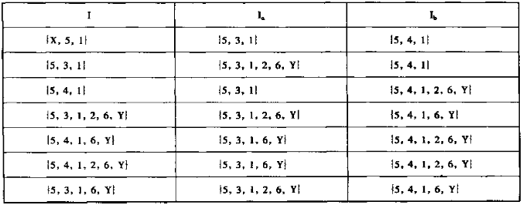
3.6 Convert NFA to DFA（subset construction）- Example
a
3
a
a
a
start
X
ε
5
ε
1
2
ε
6
ε
Y
b
b
4
b
b
Notes:
我们还以上面那个NFA为例，看看怎么将这个NFA转换为DFA。首先，求初始状态X的ε闭包，很简单它们是X，5和1，再求这个集合X，5,1的Ia集合和Ib集合。求出Ia集合5,3,1，后检查第0列，发现没有这个集合，就将它填到第2行第0列，同理求出Ib集合5，4，1，同样发现它在第0列不存在，那么将其填写到第3行第0列。下面接着求集合5,3,1的Ia和Ib集合，它们分别是这两个，发现Ia在第0列中没有，接着填入第0列，这个过程一直下去，直到第0列中的集合不在增加，整个状态转换表构造完毕。

Slide 42
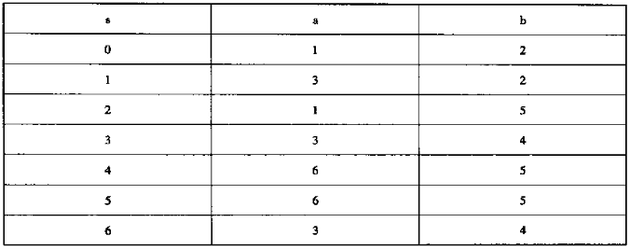
3.6 Convert NFA to DFA（subset construction）- Example
a
a
1
a
3
b
4
start
0
a
b
a
a
b
b
2
b
5
a
6
b
b
Notes:
最后，对第0列的所有状态进行重新编号，编号从0开始，它是初始状态，那些包含Y元素的集合都是终结状态。最后可以构造如图所示的DFA。

Slide 43
3.7 Minimization of DFA
Theoretical conclusion: Any regular expressions can be recognized by a unique DFA with the minimum states.
The minimum-state DFA is based on the concept distinguishable states. String x distinguishes state s from state t if exactly one of the states reached from s and t by following the path with label x is an accepting state. State s is distinguishable from state t if there is some string that distinguishes them.
E.g., empty string empty string distinguishes any accepting state from any non accepting state.
The state-minimization algorithm works by partitioning the states of a DFA into groups of states that cannot be distinguished. Each group of states is then merged into a single state of the minimum-state DFA. The algorithm works by maintaining a partition, whose groups are sets of states that have not yet been distinguished, while any two states from different groups are known to be distinguishable.

Slide 44
3.7 Minimization of DFA –Algorithm
INPUT：DFA M，F is the set of accepting states
OUTPUT： the minimum-state DFA M’
算法：（1）Construct initial partition Π，including F and S-F
（2）construct a new partition Π_{new}
for each goup G in Π do
partition G into subgroups such that two states s and t are in the same subgroup if and only if for all input symbols a, states s and t have transitions on a to states in the same group of II;
replace G in IInew by the set of all subgroups formed;
（3）if Π_{new}= Π, then Π_{final}:= Π；otherwise goto （2）
（4）Choose one state in each group of II_{final} as the representative for that group. The representatives will be the states of the minimum-state DFA M’. Those original edges pointing to “non-representatives” now point to the representatives. The group including s₀ is the initial state of M’. The accepting states of M’ are represented by the representative groups that include F.

Slide 45
3.7 Minimization of DFA –Example
a
a
1
a
3
3
b
4
start
0
a
b
a
a
b
b
2
b
5
a
6
b
b
（1）Final state group{3, 4, 5, 6}；non-final state group{0, 1, 2}， Π={{3, 4, 5, 6}, {0, 1, 2}}
（2）Since {3, 4, 5, 6}_{a}⊂ {3, 4, 5, 6} and {3, 4, 5, 6}_{b}⊂ {3, 4, 5, 6}，so {3, 4, 5, 6} cannot be partitioned any more.
（3）{0, 1, 2} _{a}={1, 3}⊈ Π，state 1 reaches state 3 on input a，but states 0,2 reach state 1 on input a ，so a new division is {0, 2} , {1}。Thus, new partition is Π={{3, 4, 5, 6}, {0, 2}, {1}}
（4） {0, 2}_{b}={2, 5} ⊈ Π，so separate 0 and 2
（5）Finally, Π={{3, 4, 5, 6}, {0}, {2}, {1}}，DFA M‘ includes 4 states

Slide 46
Conversion among FA, Regular Expression, & Regular Grammar
Regular Expression
Regular Definition
NFA
DFA
Determination
Regular Grammar
Minimization
The minimum-state DFA
Conclusion 1：For any FA M，there exists a regular expression r that L(r) = L (M)；For any regular expression r， there exists an FA M that L(M) = L (r).
Conclusion 2： For each right (left) linear grammar G, there exists an FA M that L(M) = L (G)； For any FA M，there exists a right (left) linear grammar G that L(G) = L (M).

Slide 47
NFA Regular expression
Add two node X and Y on the transition diagram of M， representing the unique initial state and final state. Draw ε-edges from X to the original initial states of M and draw ε-edges from the original final states to Y. Then, we have an extended NFA M’. Obviously, we have L(M)=L(M’).
For M ‘ , we repeatedly use the following three rules:
i
A
k
B
j
i
AB
j
A
i
j
i
A|B
j
B
A
b
i
B
k
C
j
i
BA*C
j

Slide 48
Regular expression NFA
Three basic conversions
r= ε r=ϕ r=a a∊ ∑
For r , we repeatedly use the following three rules:
q₀
q₀
q_{f}
q₀
a
q_{f}
ε
M₁
ε
q₁
f₁
Union
q₀
f₀
M₂
ε
q₂
f₂
ε
M₁
ε
M₂
Concatenation
q₁
f₁
q₂
f₂
ε
q₀
ε
M₁
ε
f₀
closure
q₁
f₁
ε

Slide 49
Right linear Grammar NFA
Grammar G=(V_{T}, V_{N}, S, 𝓟), where each production has the form ：
A → αB| α，where α∊ V_{T}*， B ∊ V_{N}
Each nonterminal in V_{N} can be a state，and add a new final state f.
Construct FA M = (V_{N}⋃{f}, V_{T}, δ, S, {f})，in which transition functions can be defined as follows.
（1） A ∊ V_{N,} a ∊V_{T}⋃{ε}，A → a has a transition function δ(A, a) = f
（2） A ∊ V_{N,} A_{i} ∊ V_{N ,} a ∊V_{T}⋃{ε}，A → aA₁|...|A_{k} has a transition function δ(A, a) = {A₁, ..., A_{k}}

Slide 50
DFA Right linear Grammar
DFA M=<S, ∑, δ, s₀, F>
If s₀∉F，另G=<∑, S, s₀, 𝓟>，𝓟 is a set of productions defined by following rules:
For any a ∊ ∑，A，B ∊ S，if we have δ(A, a) =B，Then
（1）A → aB, if B ∉F
（2）A →a| aB, if B ∊ F
If s₀ ∊ F，we add an initial state s₀’ and construct the production s₀’ → ε | s₀
Thinking：
Conversions between FA and left linear grammar?

Slide 51
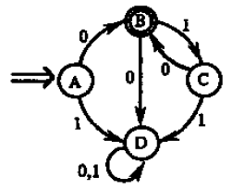
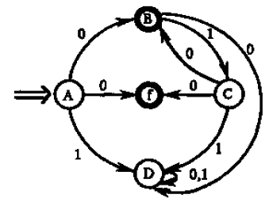
Conversion among FA, Regular Expression, & Regular Grammar – Example
A → 0|0B|1D
B → 0D|1C
C→ 0|0B|1D
D→ 0D|1D
r = 0(10)*

Slide 52
Homework
Give the tokens (including names and attributes) of the following C++ code clip.
int CInt::nMulDiv(int n1, int n2) {
if(n3 == 0) return 0;
else return (n1 * n2) / n3;
}
2. The legal file name of a system has the form
device:name.extension
device and extension are optional. Simply, device, name and extension are strings without length limitation (but at least include one character). Draw a transition diagram to recognize the file names. (For simplicity, you can use a letter d for any legal input character)

Slide 53
Homework
3.Write the corresponding regular expressions for the following strings.
(1) Binary strings that end with 01
(2) Decimal integer strings than can be divided by five without remainder.
(3) Binary strings that include odd 1 or odd 0.
4.Construct an NFA for regular expression 1(0|1)*101, then convert the NFA to DFA.
5.Construct a DFA that can accept strings on that include even numbers of 0 and even numbers of 1.

Slide 54
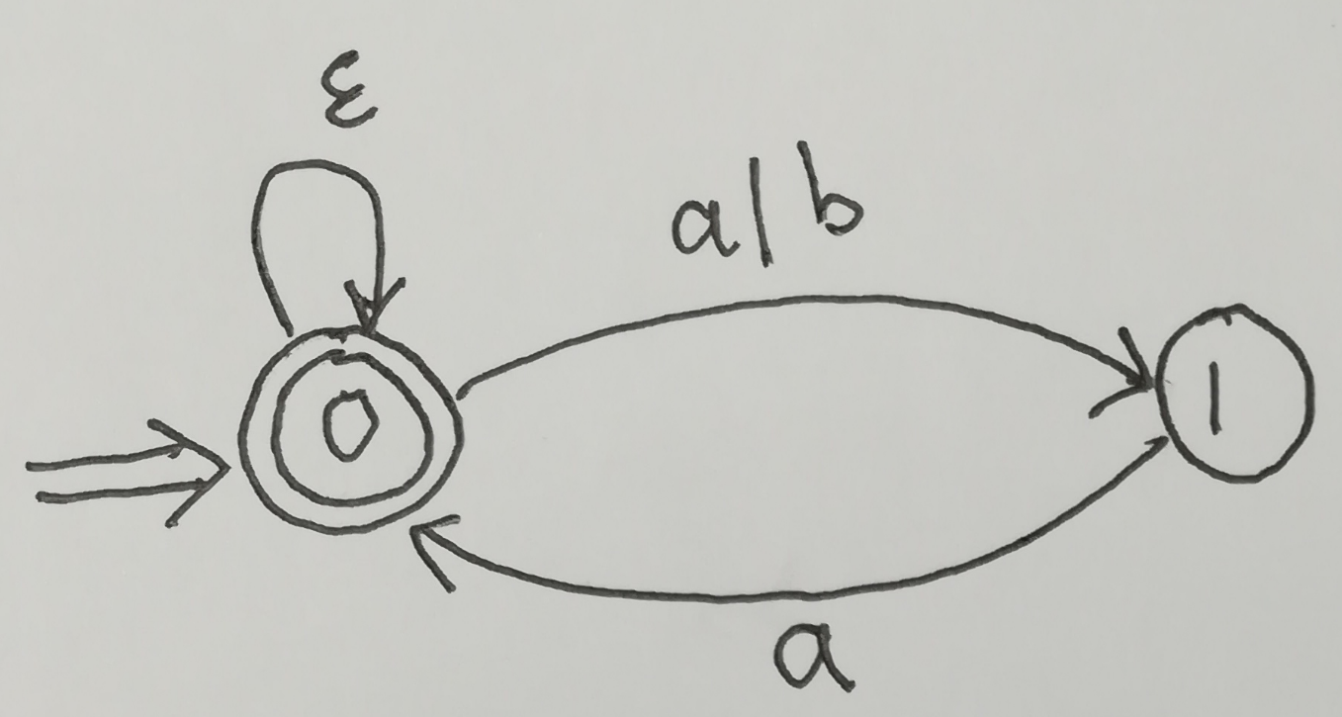
Home work
5. Convert the following NFA to DFA

Slide 55
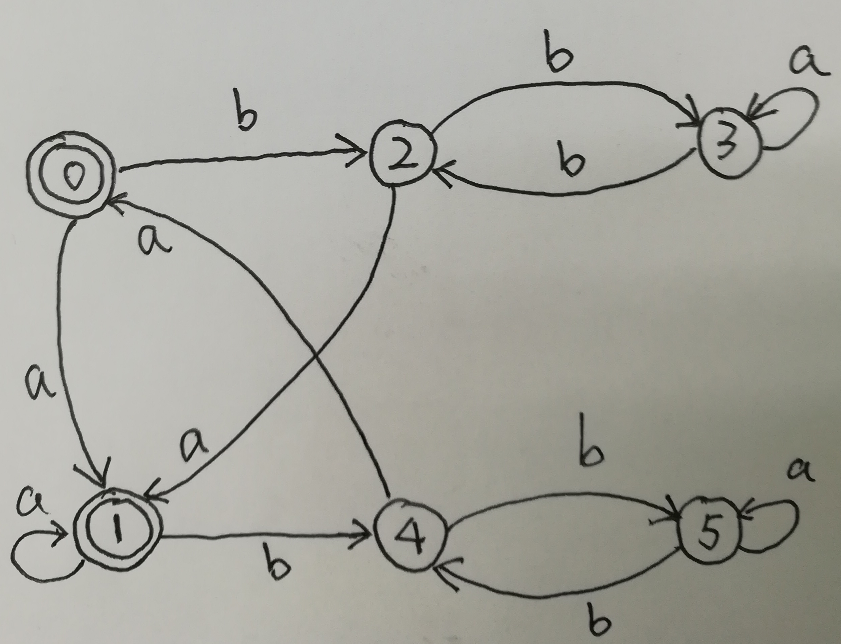
Home work
6. Minimize the following DFA

